Slide 1
Rice Solution
Presenter, Title, Dates
Dataman.ERP

Slide 2
Introduction
Dataman.ERP

Slide 3
Disclaimer
This presentation is designed and conducted by Dataman Computer Systems as per the understanding of the requirement. Though this is a power point presentation, the screen shots are taken from the configured ERP . The objective of the PPT is to reduce on presentation time.
Dataman.ERP

Slide 4
Agenda
Topic | Estimated Time
Describe Methodology | 2 Min
Business Concept & Criticality | 5 Min
Proposed Solution | 50 Min
Live Demonstration | 20 Min
Discussion | 10 Min
Approximate Total Duration | 1 Hour 30 Min
Dataman.ERP

Slide 5
Methodology
The methodology for the today’s presentation will be a mix of:
Business Process & Criticalities
Proposed Solution
Live Demonstration in ERP.
Dataman.ERP

Slide 6
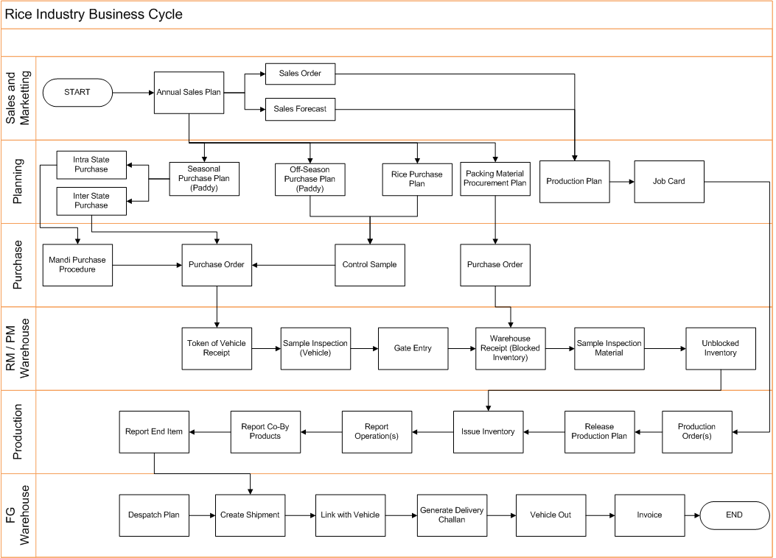
Business Concept
Dataman.ERP

Slide 7
Solution Focus Areas
Sales
Order booking with Customer Specifications
Central Export Order Booking
Export Planning and Scheduling
Dispatch from Shipping Location to Port
Dispatch from Port to Customer
Daily Dispatch Plan - Domestic
Dispatch from an Alternate Location
Forecasting
Consumption of Forecast by following Sales Order(s)
Purchase
Mandi Procurement System (Open Market Purchase)
Control Sample based Purchase (Paddy and Rice)
Dataman.ERP

Slide 8
Solution Focus Areas
Planning
Sales Order Requirement based Planning
Yield based material requirement planning
Processing Capacity based Monitoring
Production
Standard Yield Definition Operation wise
Expected Yield based resource requirement planning
Actual Yield calculation based on quantities produced
Bardana Tracking System
Controls based on Gate Entry
Quality control based on single sample from a vehicle pre Gate Entry
Quality Control based on samples from 100% Bags
Dataman.ERP

Slide 9
DCSPL Rice Industry Capability
DCSPL has delivered solutions for a number of customers operating in Indian rice industry and catering to domestic and international business. These customers include the top players in the rice industry
DCSPL over the years, has developed an in-depth understanding of rice industry specific business processes, especially the “Mandi Supply Chain” for paddy procurement processes that are not possible to be addressed through implementation of a standard ERP packages
Dataman.ERP

Slide 10
DCSPL Rice Industry Capability
DCSPL offers an end to end business solution for rice industry
DCSPL has developed a Rice Industry specific Solution on dataman ERP platform to cover Mandi Supply Chain, production processes, stack costing, Bardana tracking, Logistics control etc.
Standard templates map to cross industry processes
Leadership in ERP implementation for rice and paddy industry
More than Rs. 500 crores worth of paddy procured from mandi through DCSPL developed “Mandi Supply Chain System” on top of standard ERP’s for Rice and Food Processing Industries.
All the leading rice brands in India work on DCSPL developed system e.g. Shri Lal Mahal, Namaste Ji, Ripuraj, Maharani, Sukhbir etc.
Dataman.ERP

Slide 11
DCSPL Rice Industry Domain Expertise
Critical factors in Rice Industry
Seasonal and open market purchase of the paddy based on the Mandi terms
Bardana Management
Testing of the Paddy for the Yield for the estimation vs actual
Stack Costing
Inventory Valuation to include:
Carrying cost
Other expenses e.g. Loading,Unloading,Tulai,Others Charges, etc
Batch Costing
Contract labor tracking
Tracking of Lot to Kaccha Aarthi Level
Estimation for quotations based on availability of paddy
Variation Inventory based on moisture content
Inspection before receipts
Dataman.ERP

Slide 12
DCSPL Rice Industry Solution Highlights
Paddy Demand Calculation
Based on the forecast entered in system
Based on the actual sales order booked
Based on the success percentage of the sales offers
Considering the stock in hand at each stage
MRP calculates the required demand at each stage
Paddy Inspections
Moisture driven characteristics like yield is also calculated on standard moisture say 12°
Quality points are deviated based on deviation of “moisture after drying” from the “standard moisture”
Dataman.ERP

Slide 13
DCSPL Rice Industry Solution Highlights
Production Plan
Similar to the paddy demand calculation, system calculates the demand at each stage of production like:
Paddy to be dried
Husking Unit
Polishing Unit
Sortex Unit (Brand to be packed)
Paddy Procurement System
Support all type of purchases vi:
Direct Purchase (D2 purchase)
Indirect Purchase
Seasonal Purchase
Off-season purchase
Purchase Offering system provide us a better control on commission agent.
Price band can be specified
Dataman.ERP

Slide 14
DCSPL Rice Industry Solution Highlights
Paddy Procurement System
Offer validity period can be specified
Quantity limit can be specified
Support centralize procurement in case of multiple processing plant
Automatic creation of purchase order based on the purchase offer at the time of gate entry of paddy
Automatic calculation of other charges like Dami, Commission, freight, etc
Supplier performance analysis based on his delivery deviation from purchase offer
Daily Mandi arrival and Competitors purchase recording facility
Paddy Receipt
At the time of receipt of paddy, purchase offer is compared for price, date and quantity validation
Dheri wise receipt is entered for dheri wise price accounting and to enable farmer level tracking
D2 receipts are entered in the respective branch warehouse
Purchase offer quantity is reduced after entering the receipt
Dataman.ERP

Slide 15
DCSPL Rice Industry Solution Highlights
Paddy Inspection
Paddy inspection criteria is user defined
Rice inspection criteria is user defined
Various characteristics can be parameterize like:-
For Basmati, length>7.5 is “A” class
For Permal, length>6.5 is “A” class
Automatic Quality Points calculation based on the user defined formula
Automatic calculation of price paid/quality point
Paddy / Rice samples inspection
Quality results comparison of sample and actual delivery
Characteristics listed below are stored with the lot till last stage of the production:
Admixture
Chalky
Green/Red/Immature Grain
Yield
Dataman.ERP

Slide 16
DCSPL Rice Industry Solution Highlights
Paddy Stacking
Loading and Unloading cost is captured
Contractor account is updated online based on the work carried out by the contractor
Stack rotation charges
Tarpal rotation charges
Fumigation charges
Packing charges
Interest cost
Selection of Stack for Processing
Each Dheri is stored as a unique lot in the system
Lab results of a receipt is stored as the lab results of all the lots from that receipts
Various dheries are stacked at stack
Weighted average of all the lots stacked at a stack is the total quality of that stack
Dataman.ERP

Slide 17
DCSPL Rice Industry Solution Highlights
Selection of Stack for Processing
Based on the required quality of rice to be produced, various quality stacks can be blend
Standard/Budgeted/Actual
Standard yield is defined in formula
Budgeted yield is the lab yield of stacks selected for processing
Actual yield is reported into the system as total input for the batch and total outcome of the batch
Actual Costing
Material cost - cost of input paddy
Operation cost – standard labor, machine and overhead cost
Packing cost – packing material cost
Power cost – fuel and power cost (Generator / State electricity board)
Interest cost – Interest cost since purchase
Co/By product cost – sales realization value of last month
Dataman.ERP

Slide 18
DCSPL Rice Industry Solution Highlights
Batch/invoice wise Profitability
Cost / Qtl = Total cost of batch / Produced Quantity
Sale / Qtl = Total sale amount of the lot produced by the batch in concerned
/ Total sale quantity of that lot
Profit = (Sale / Qtl) / (Cost / Qtl)
Bardana Accounting
Mandi wise grading & tracking of bardana
Details of filled & unfilled bardana with location
Bardana depreciation calculation
Contractor Charges
Contractor task price master
Work order is created for the contractor
After processing of work order, contractor charges are uploaded on
the inventory (lot / batch) on which task is carried out
Dataman.ERP

Slide 19
DCSPL Rice Industry Solution Highlights
Contractor Charges
Task like stack rotation are carried out on stack. System however finds out the dheri available on that stack at that time and divide and upload the cost on all lots based on weighted average
Interest Cost
Interest rate for different period is calculated based on cost of fund
Interest cost is uploaded on the batch at the time of batch cost calculation
Interest cost is calculated on the period from the date of receipt minus credit period of the lot up to consumption date
Dataman.ERP

Slide 20
Some DCSPL Customers
Commodities & Paddy Procurement & Processing Solution on Dataman ERP.
Shri Lal Mahal ltd.
R.P. Basmati Rice Mills.
Ripuraj Agro
Sukhbir Agro.
Chaman Lal Sethia Exports Ltd.
Jhunjhun Wala Oil Mills Ltd.
Dataman.ERP

Slide 21
Business Criticalities
Sales
Sales Contract
Sales Order
Forecasting
Consumption of Forecast by following Sales Order(s)
Planning
Purchase Plane is based on Statistical Inventory Control
Production Plan is hybrid of Demand Specific & Make to Stock
Purchase
Purchase Contract / Bulk Purchase Order
Delivery Schedule as per Production Plan
Manufacturing
Material Requisition
Variable consumption of molten Chocolate, based on the volume of the Stuff (Dates & Almonds)
Finished Product is Lot (Batch) Controlled
Weighment of Finished Chocolate Lot
Dataman.ERP

Slide 22
Proposed Solution – Gate Management
Dataman.ERP

Slide 23
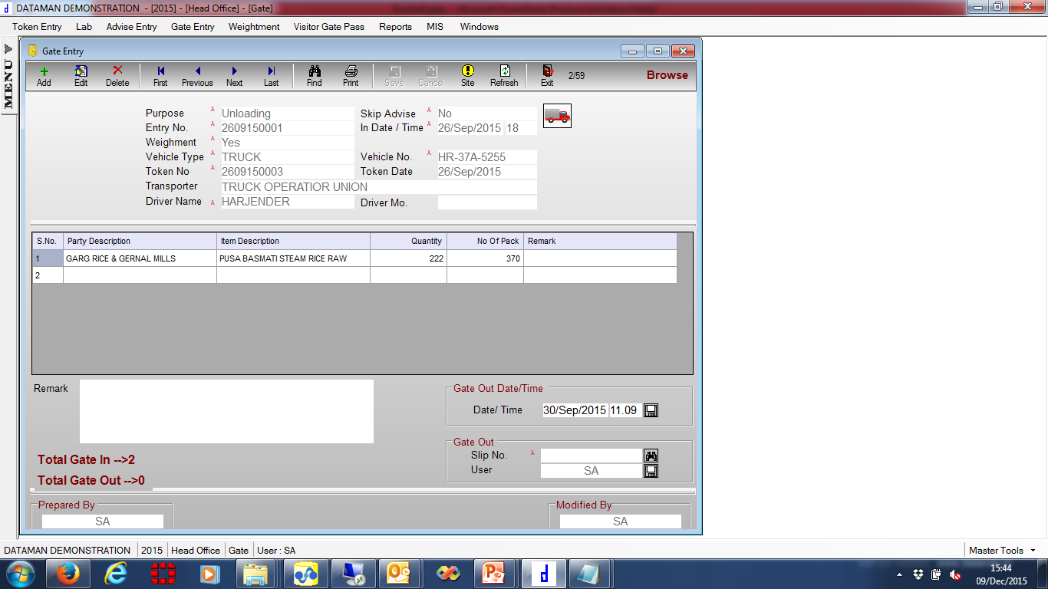
Gate Entry
Dataman.ERP

Slide 24
Pre Sampling
Dataman.ERP

Slide 25
1st Weightment Entry
Dataman.ERP

Slide 26
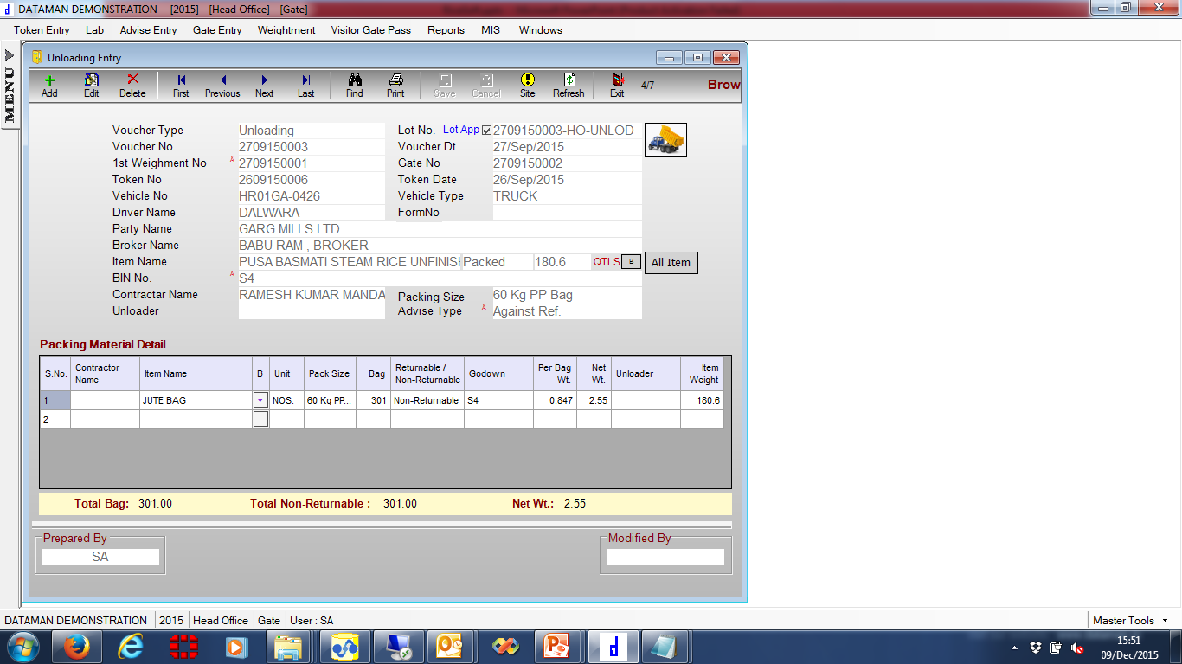
Unloading Entry
Dataman.ERP

Slide 27
2nd Weightment Entry
Dataman.ERP

Slide 28
Post Sampling
Dataman.ERP

Slide 29
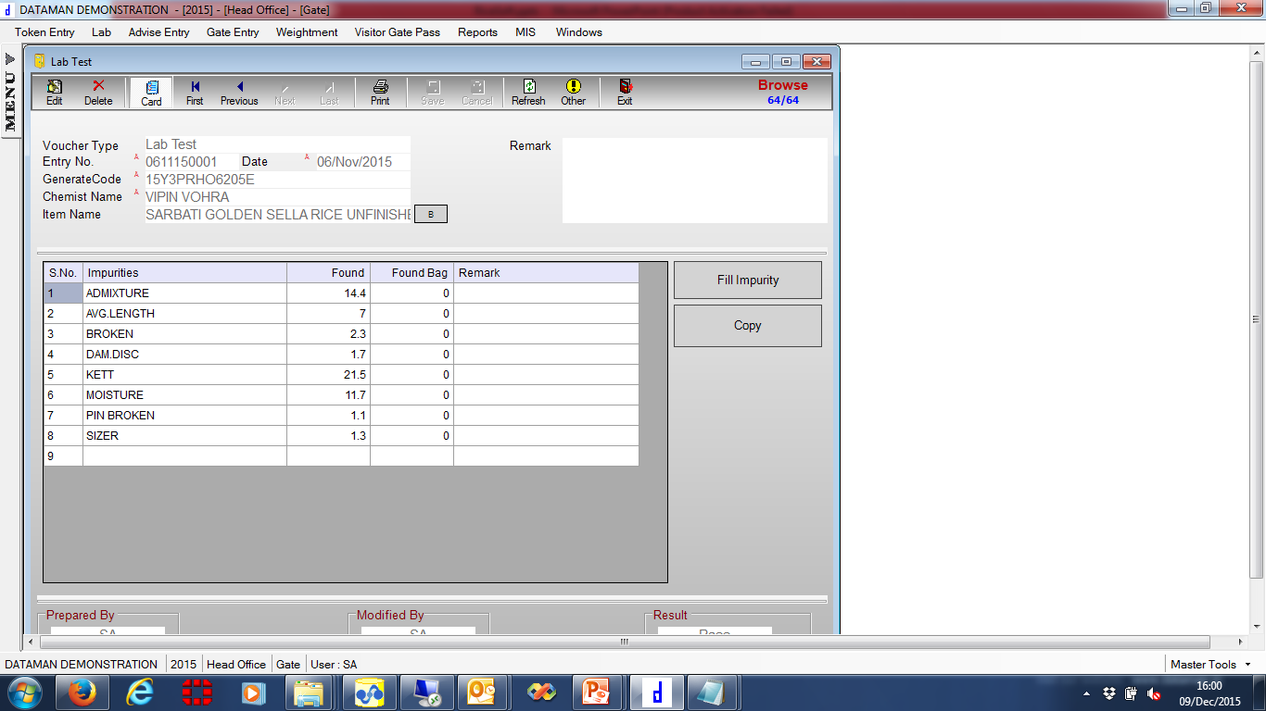
Lab Test
Dataman.ERP

Slide 30
Visitor Gate Pass Entry
Dataman.ERP

Slide 31
Proposed Solution – Sales & Marketing
Dataman.ERP

Slide 32
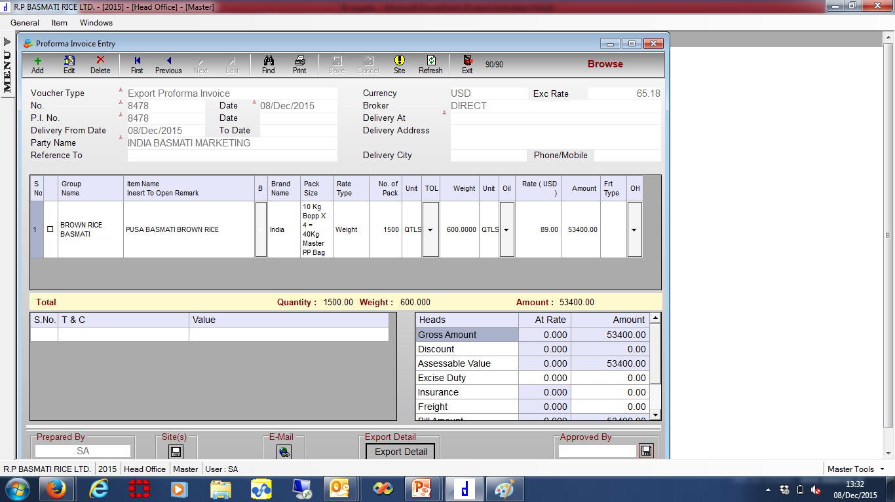
Performa Invoice Data
Dataman.ERP

Slide 33
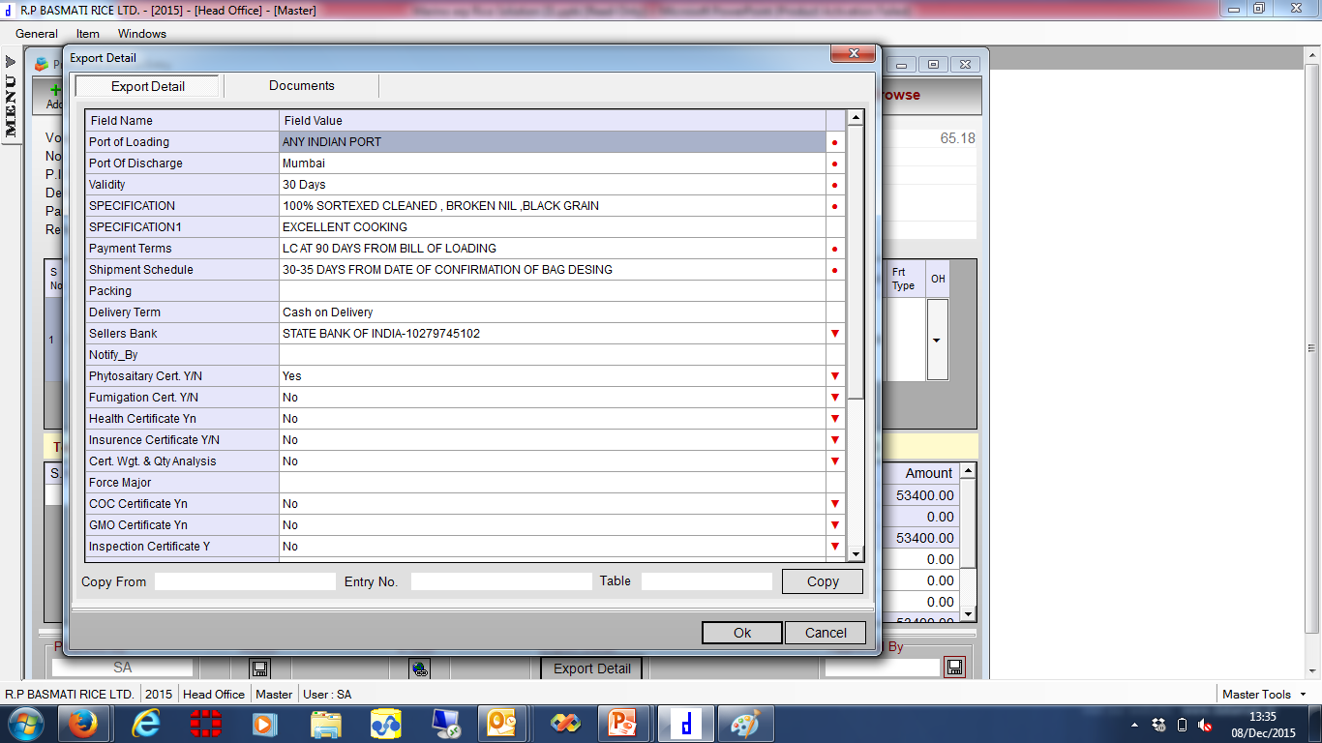
Performa Invoice Data
Dataman.ERP

Slide 34
Performa Invoice
Dataman.ERP

Slide 35
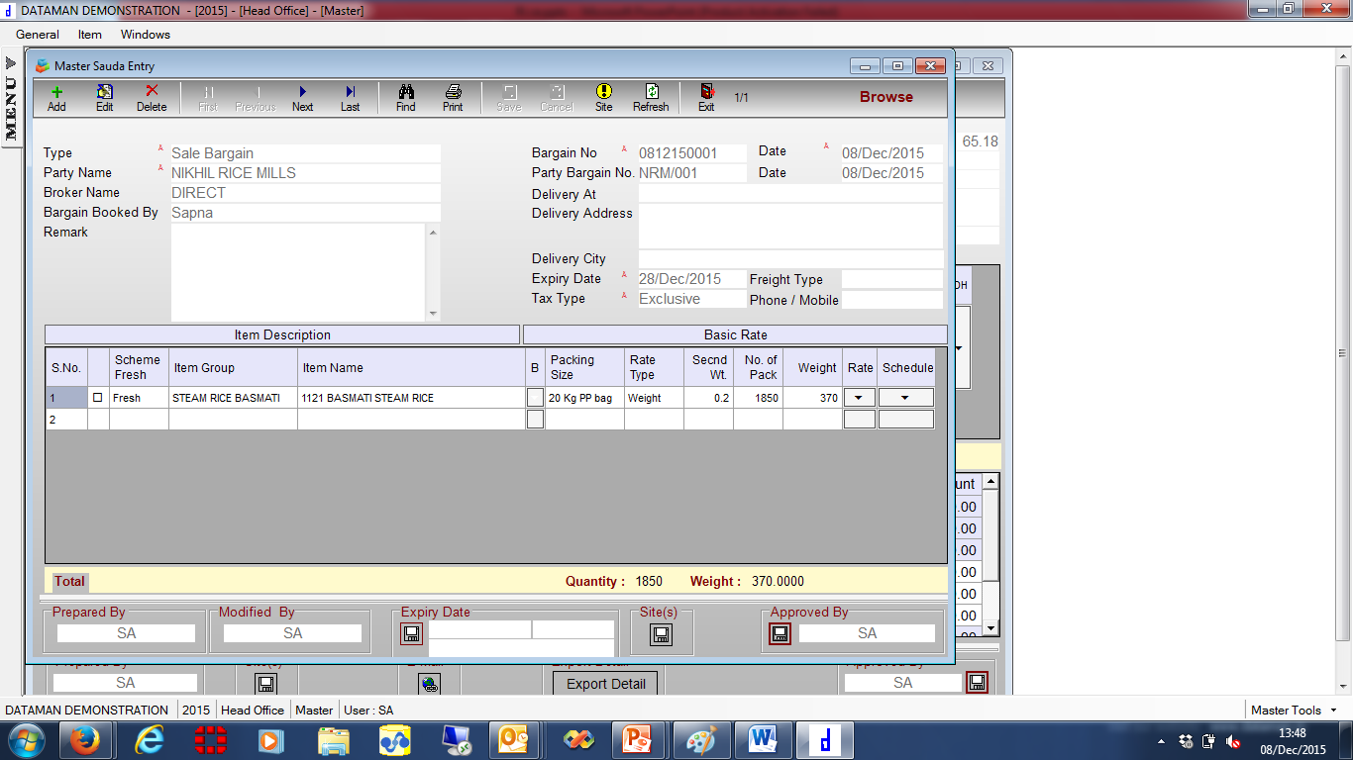
Sale Bargain Data
Dataman.ERP

Slide 36
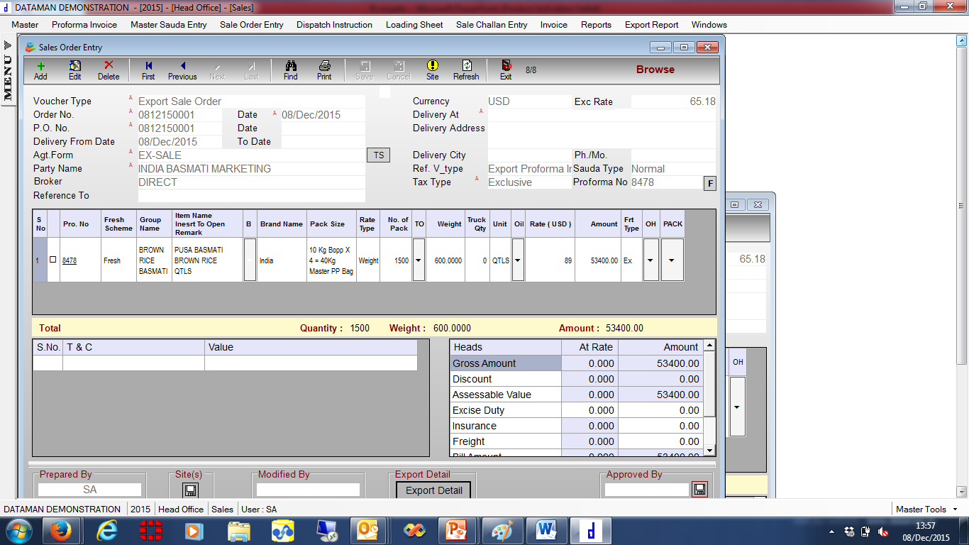
Sale Order Generation
Dataman.ERP

Slide 37
Sale Order
Dataman.ERP

Slide 38
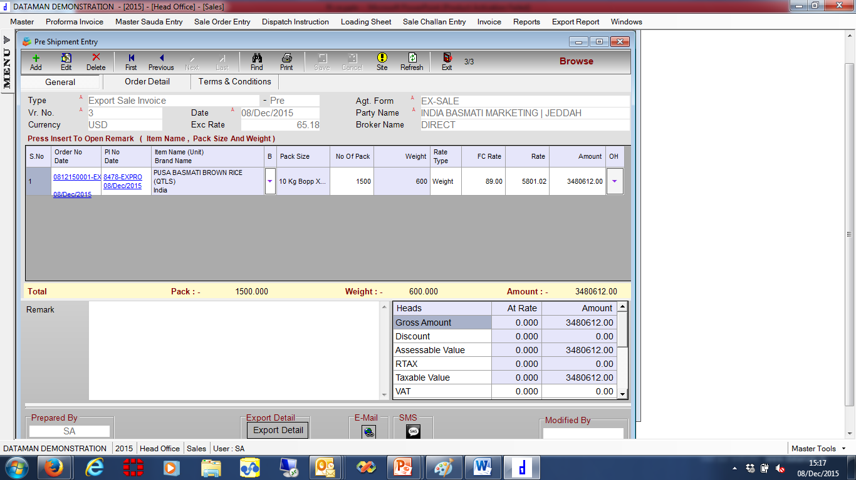
Sale Pre Shipment
Dataman.ERP

Slide 39
Sale Pre Shipment
Dataman.ERP

Slide 40
Sale Packing List
Dataman.ERP

Slide 41
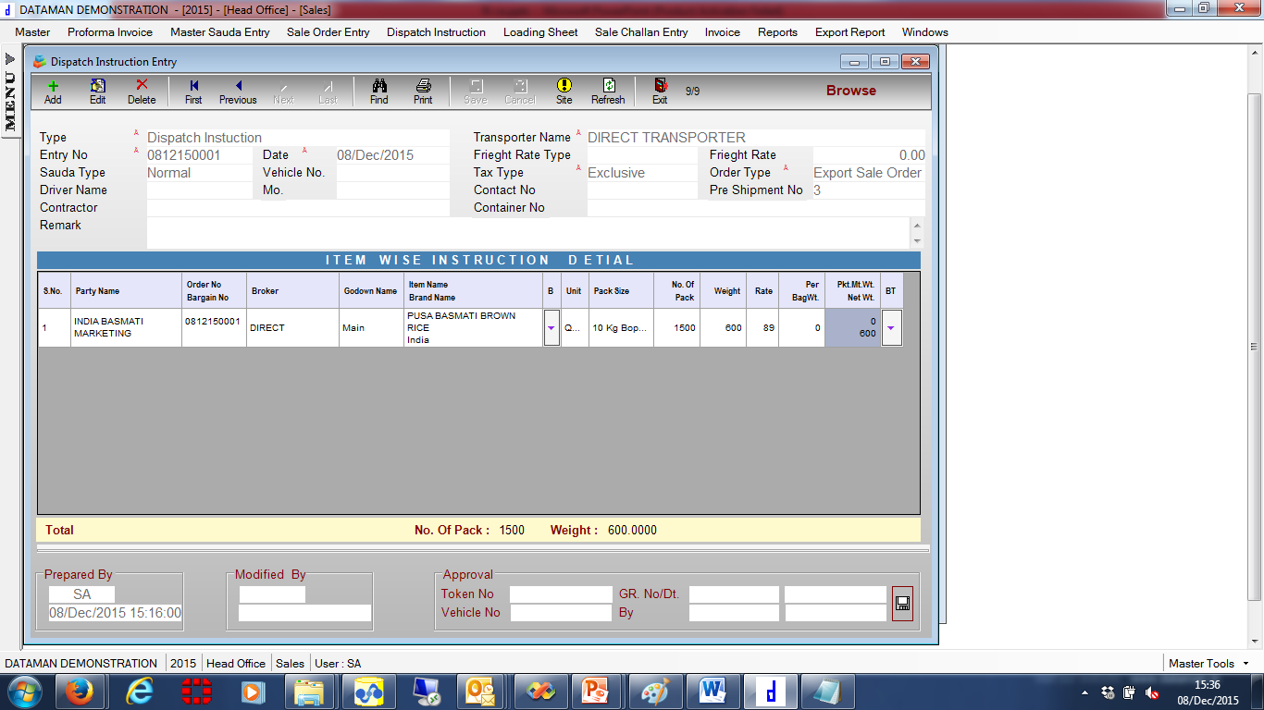
Dispatch Instruction Generation
Dataman.ERP

Slide 42
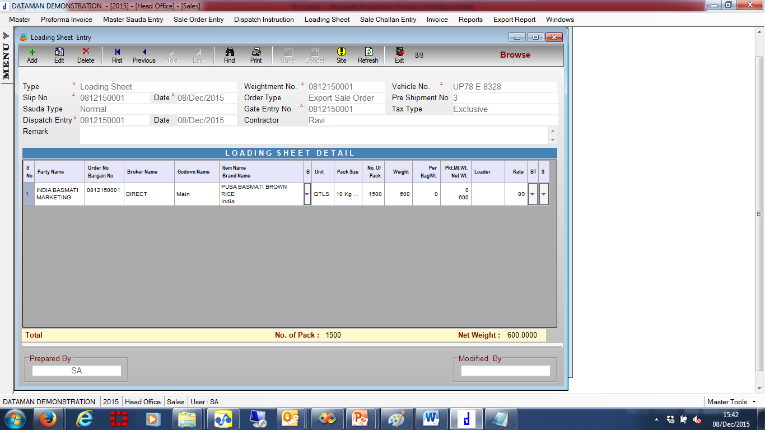
Loading Sheet Entry
Dataman.ERP

Slide 43
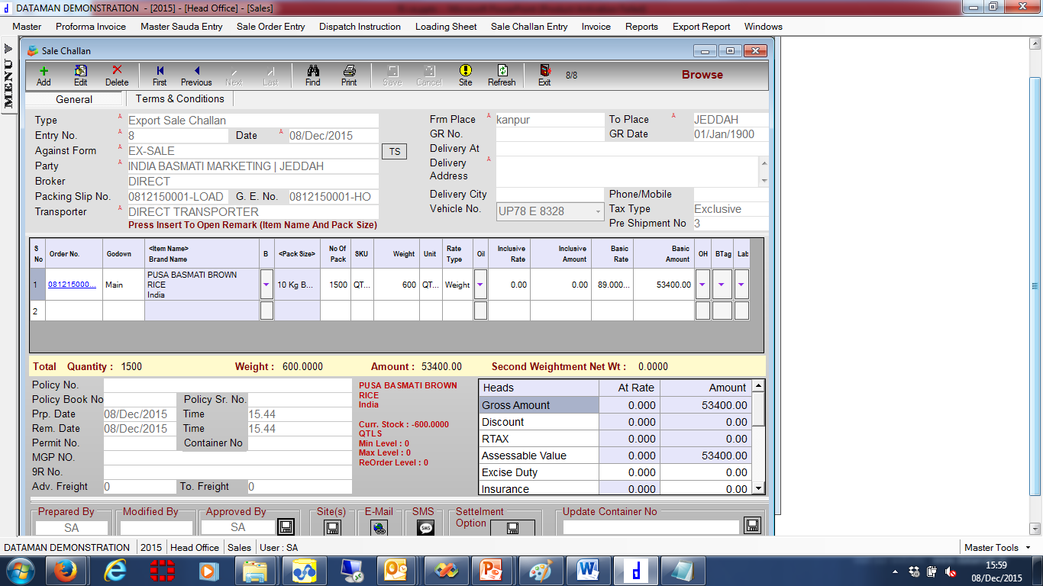
Sale Challan Generation
Dataman.ERP

Slide 44
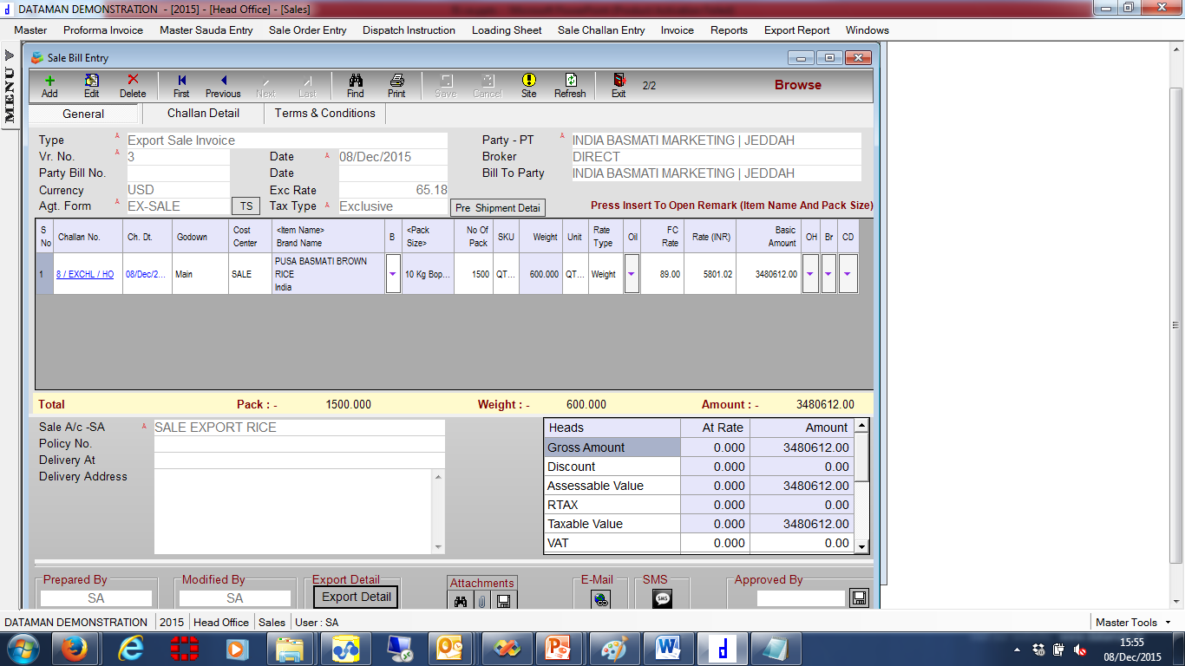
Sale Invoice Generation
Dataman.ERP

Slide 45
Commercial Invoice
Dataman.ERP

Slide 46
Invoice
Dataman.ERP

Slide 47
Proposed Solution – Purchase
Dataman.ERP

Slide 48
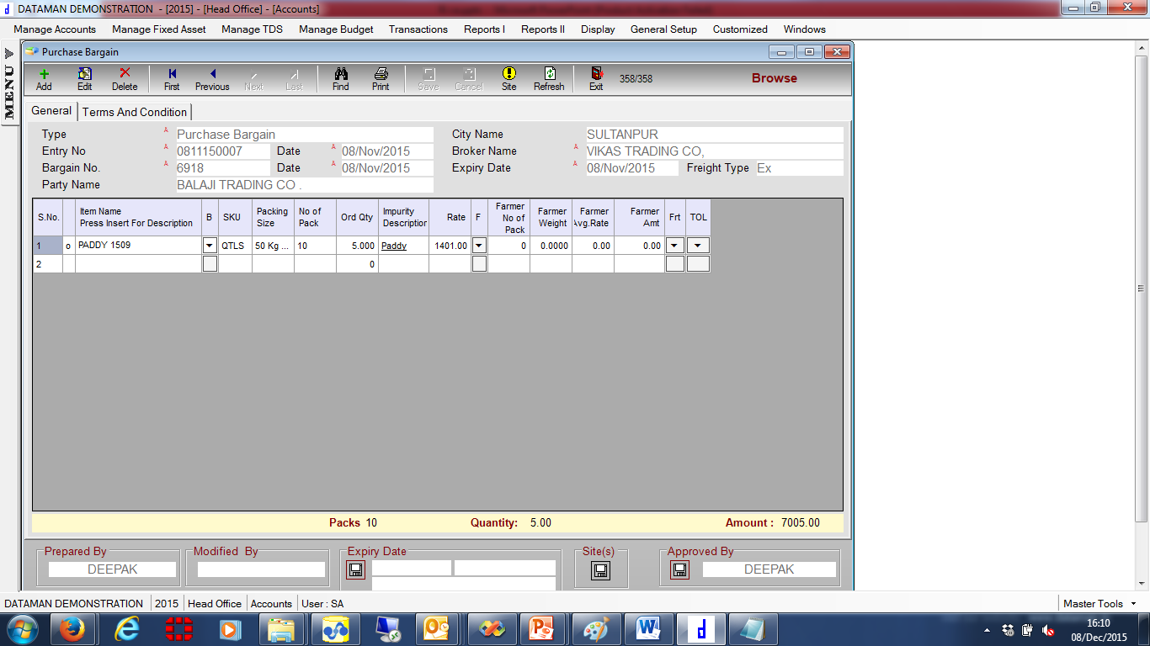
Purchase Bargain Data
Dataman.ERP

Slide 49
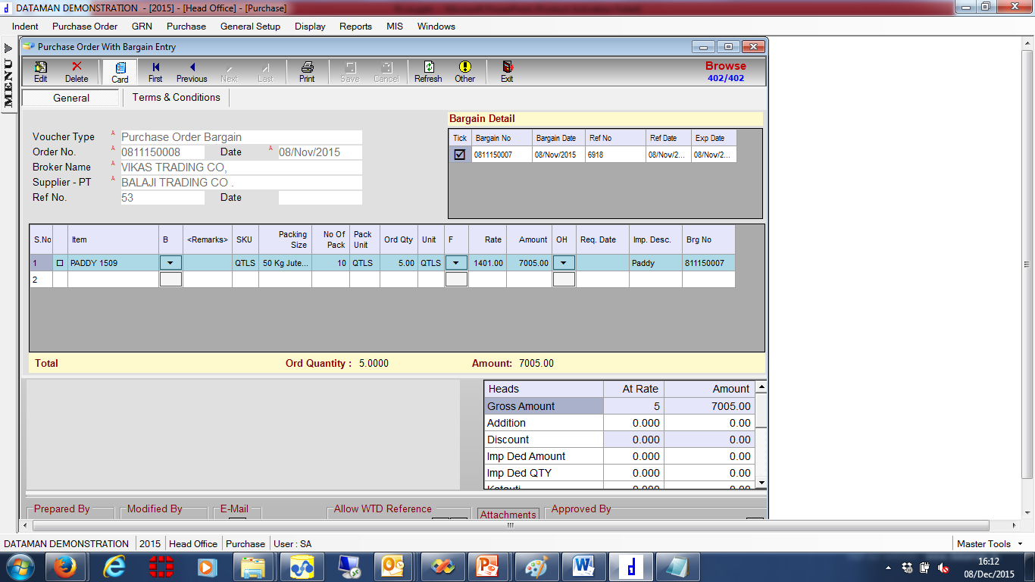
Purchase Order Data
Dataman.ERP

Slide 50
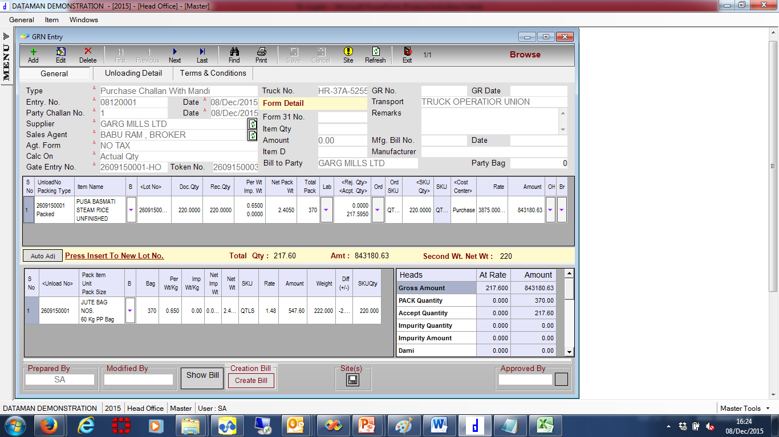
GRN Data
Dataman.ERP

Slide 51
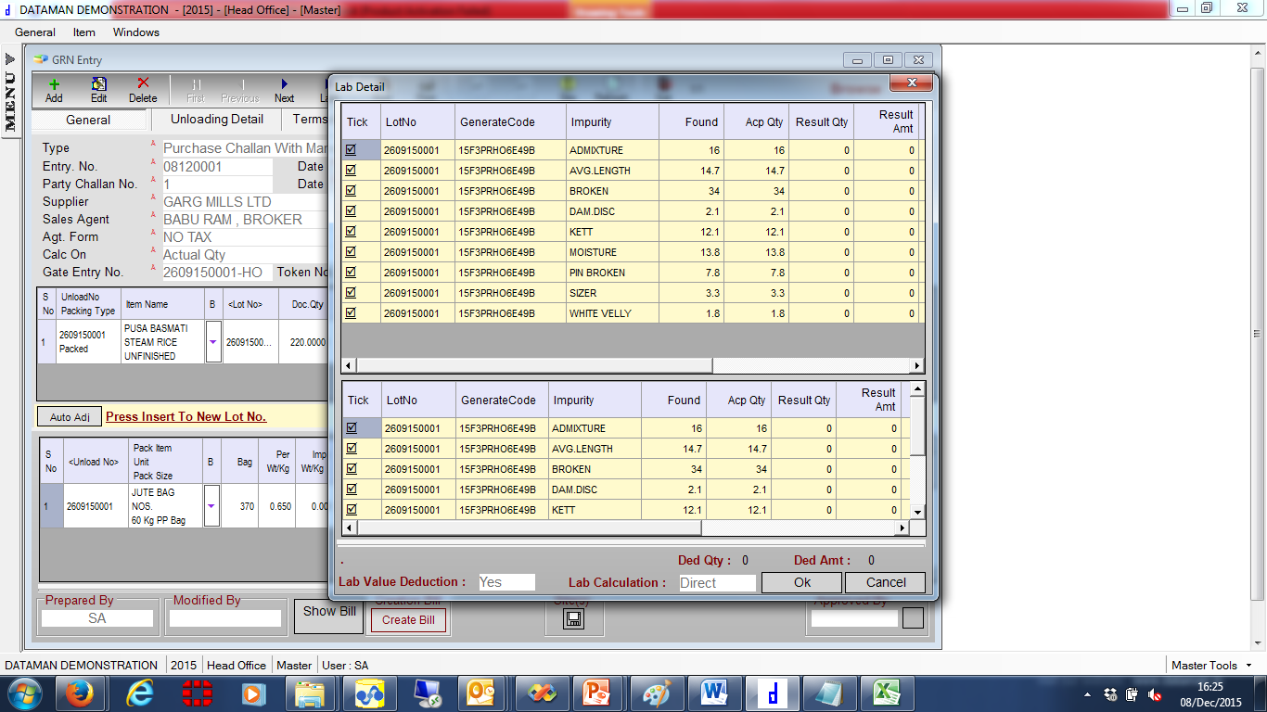
GRN Data
Dataman.ERP

Slide 52
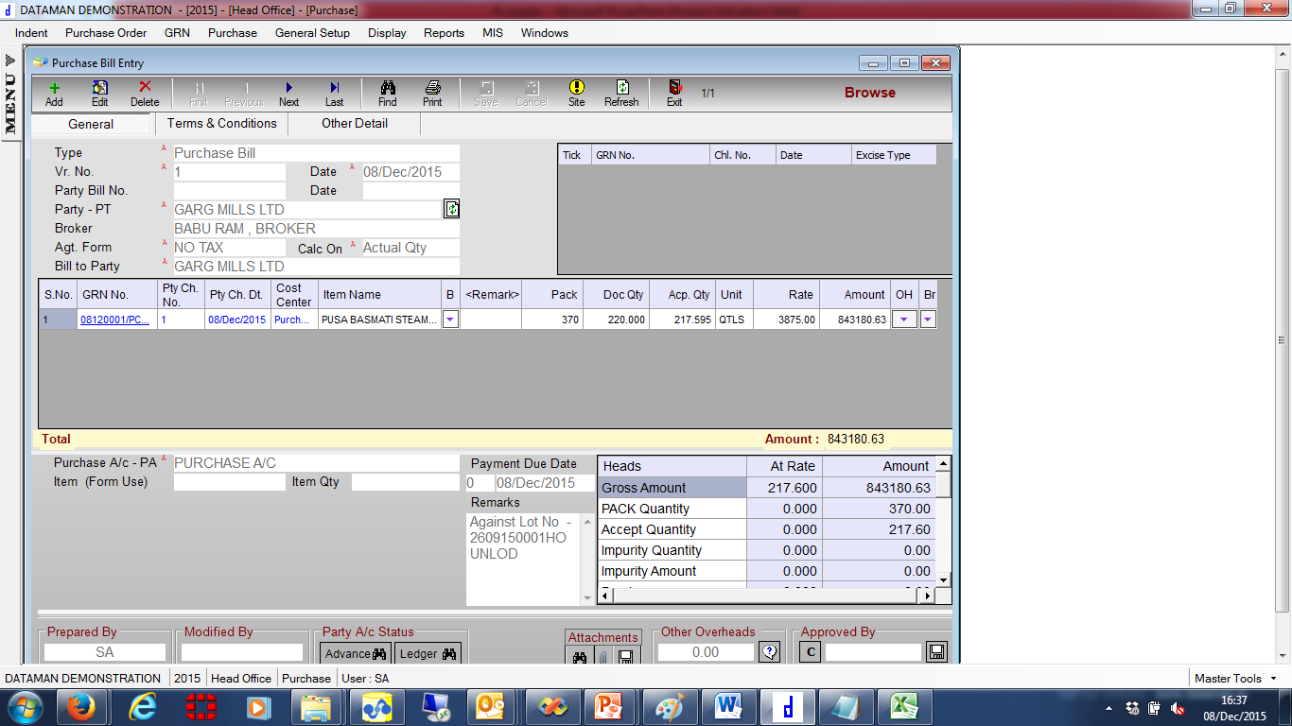
Purchase Bill Data
Dataman.ERP

Slide 53
Purchase Bill
Dataman.ERP

Slide 54
Proposed Solution – Manufacturing
Dataman.ERP

Slide 55
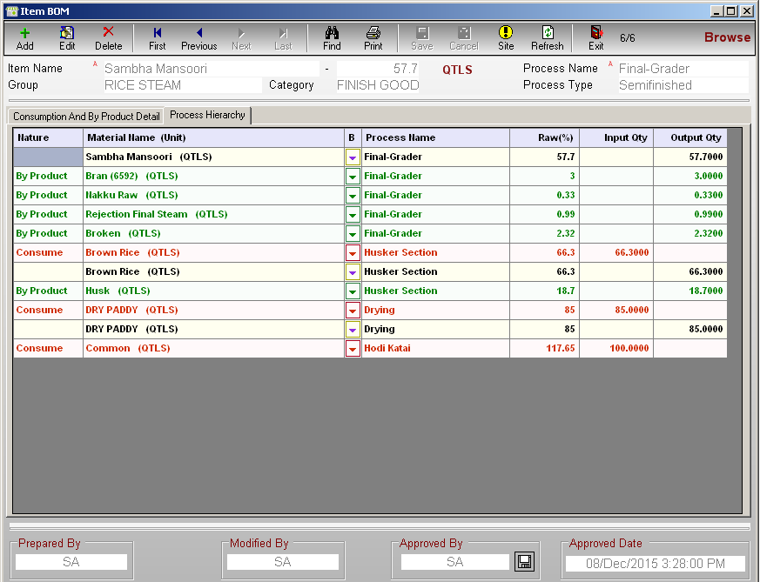
Item Bom
Dataman.ERP

Slide 56
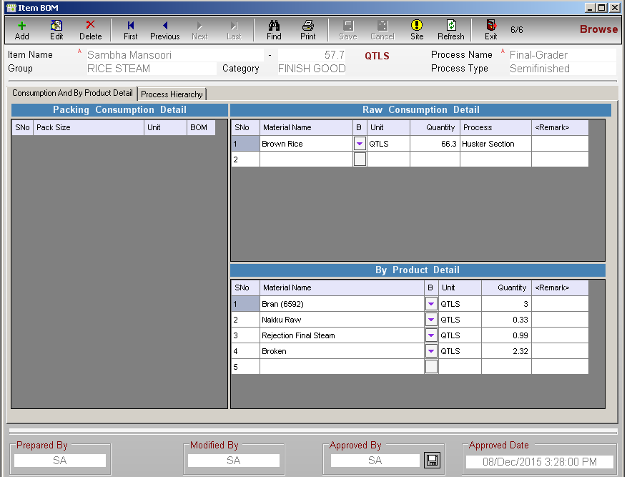
Item Bom
Dataman.ERP

Slide 57
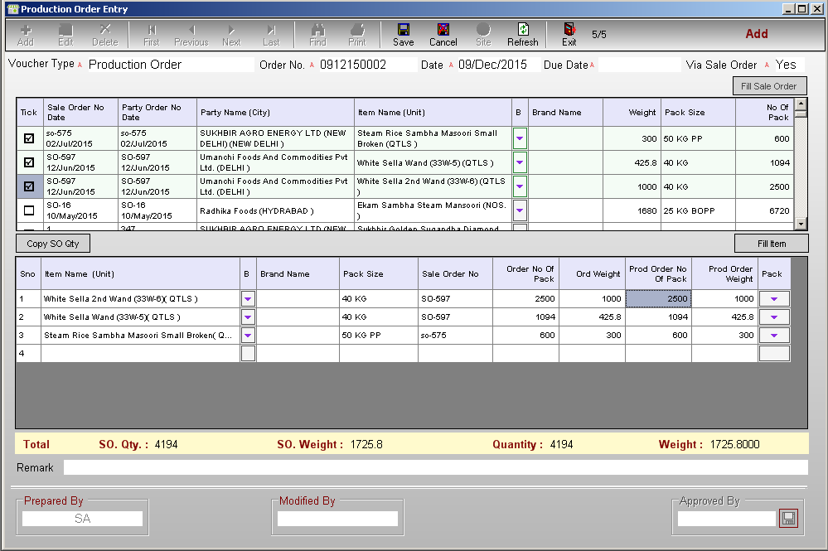
Production Order Entry
Dataman.ERP

Slide 58
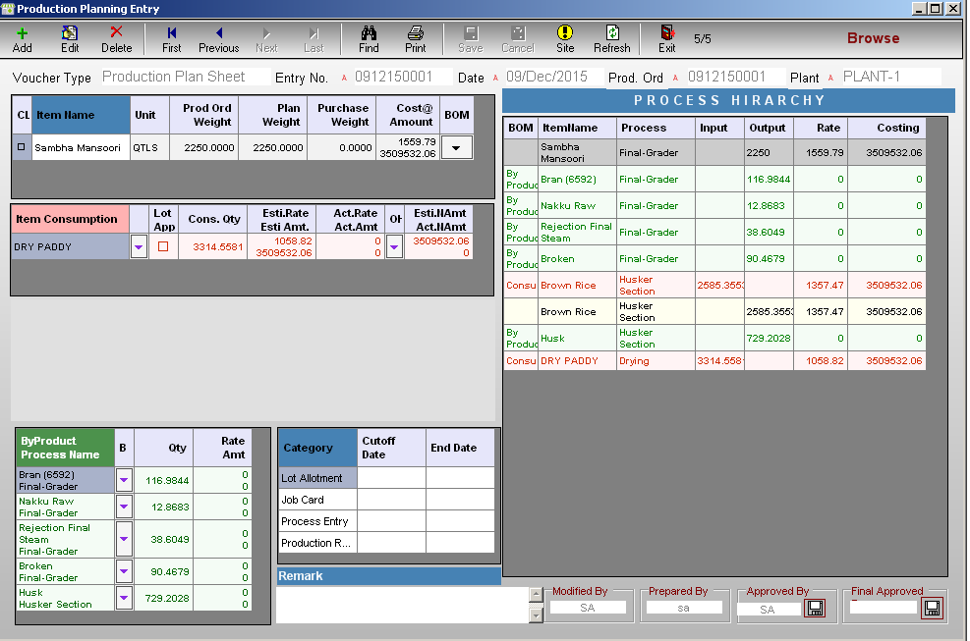
Production Planning Entry
Dataman.ERP

Slide 59
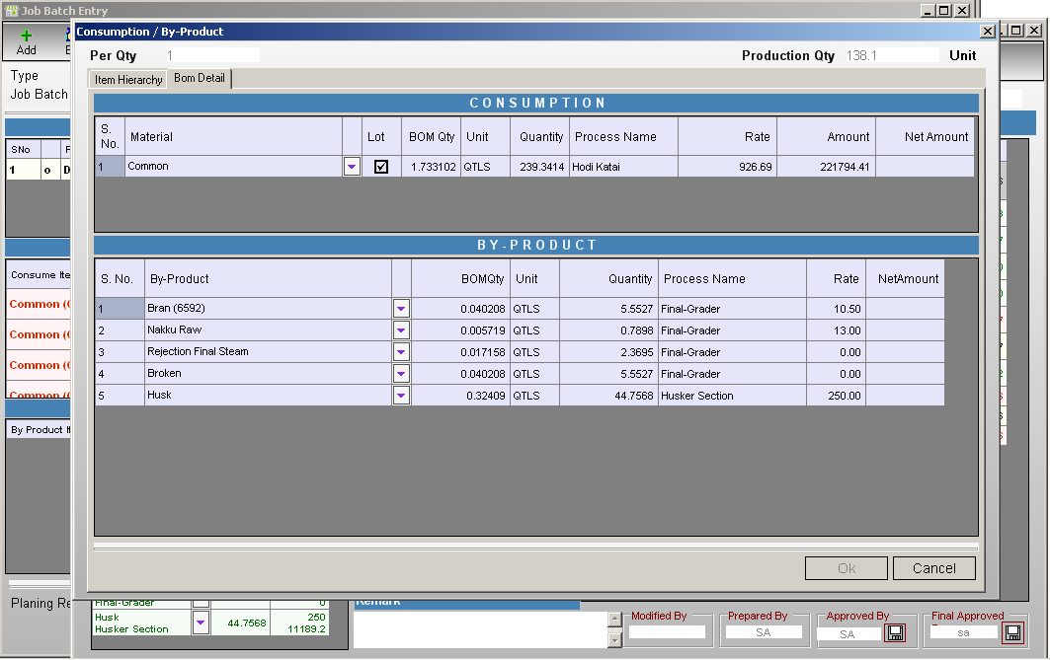
Production Planning Entry
Dataman.ERP

Slide 60
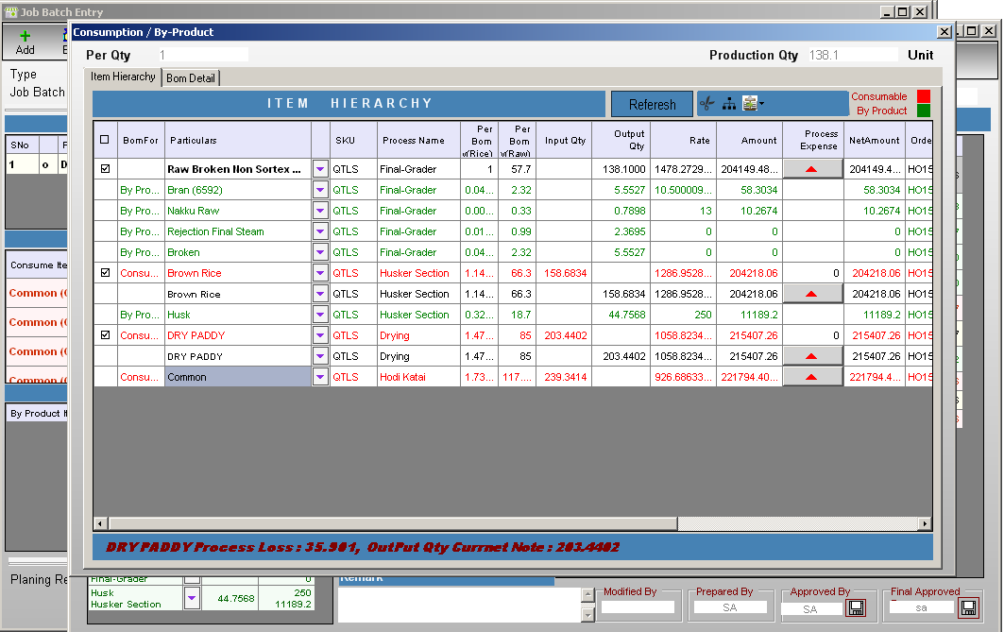
Production Planning Entry
Dataman.ERP

Slide 61
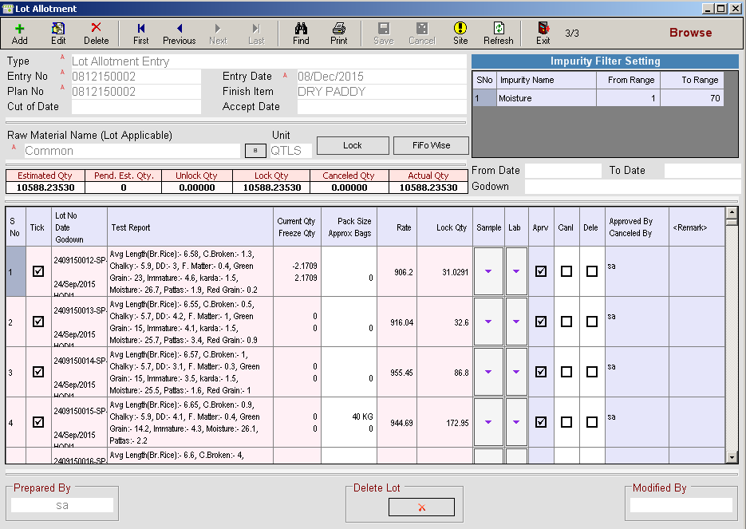
Lot Allotment
Dataman.ERP

Slide 62
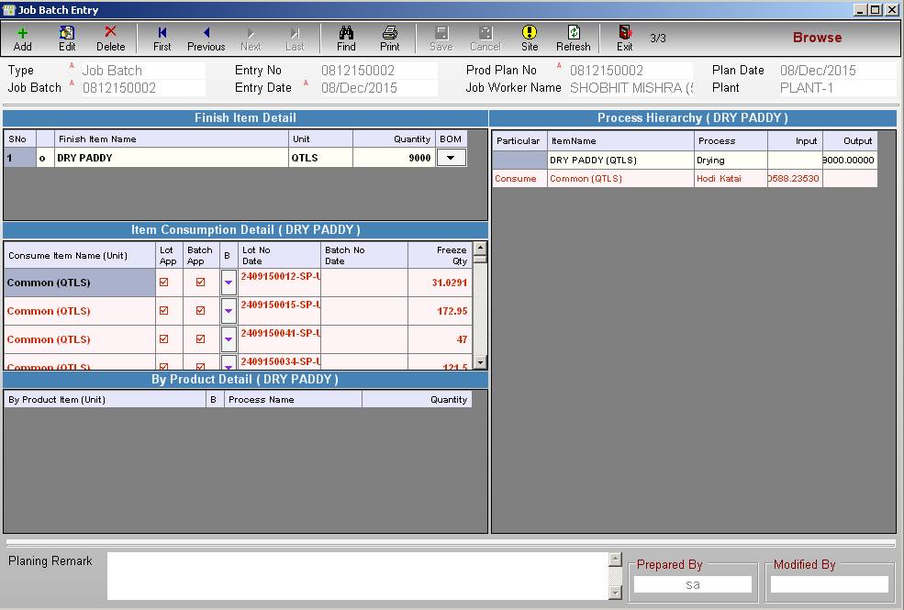
Job Batch Entry
Dataman.ERP

Slide 63
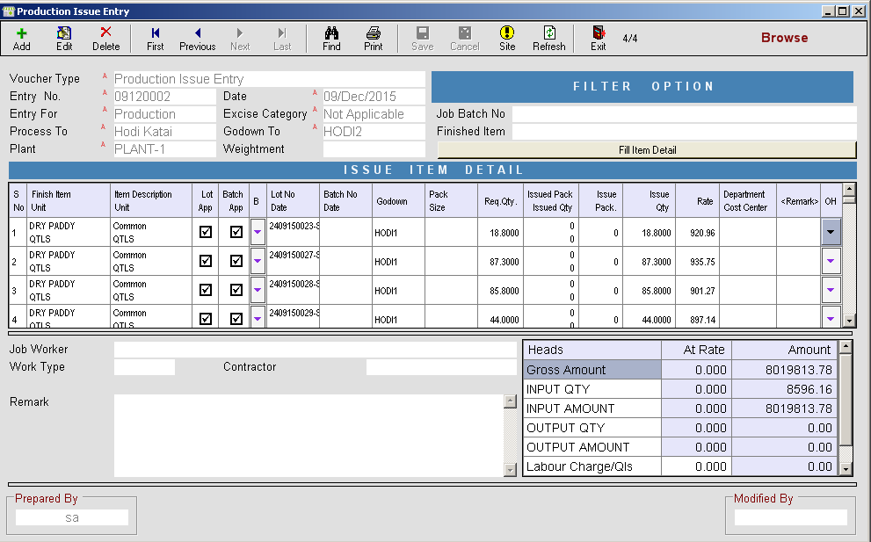
Production Issue Entry
Dataman.ERP

Slide 64
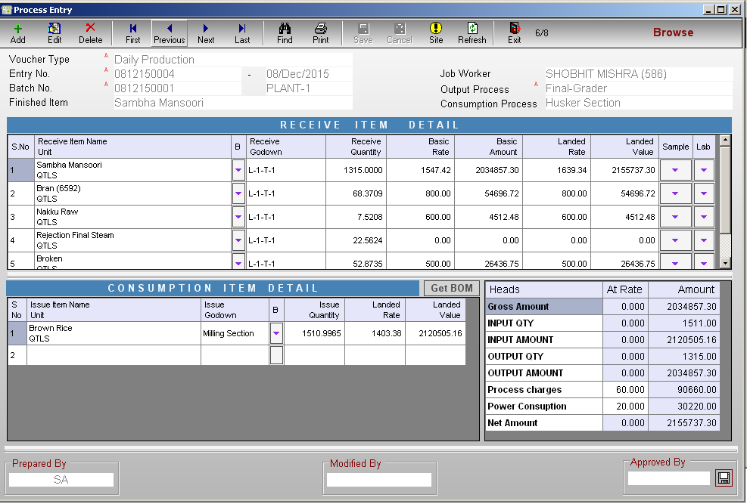
Process Entry
Dataman.ERP

Slide 65
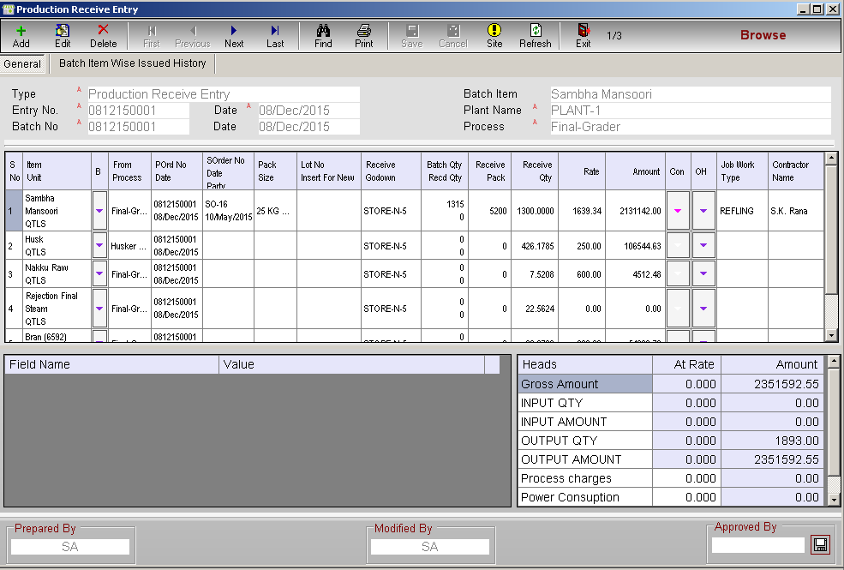
Production Receive Entry
Dataman.ERP

Slide 66
Proposed Solution – Warehouse
Dataman.ERP

Slide 67
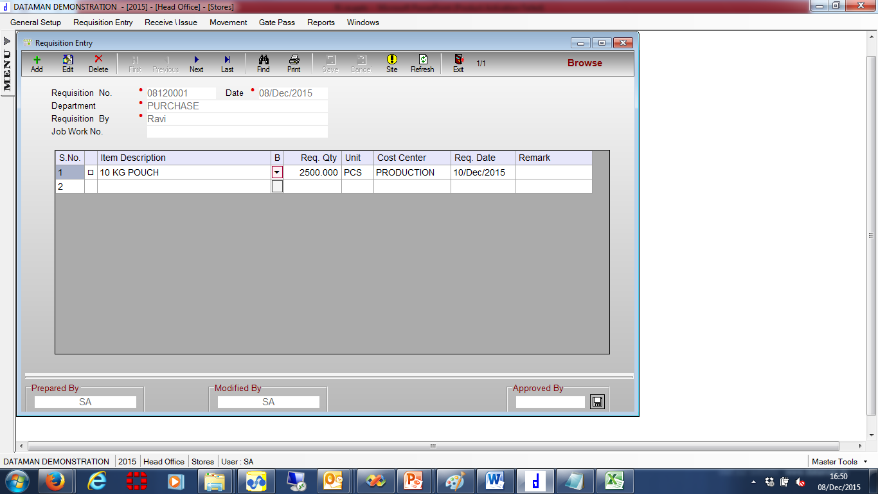
Requisition Entry
Dataman.ERP

Slide 68
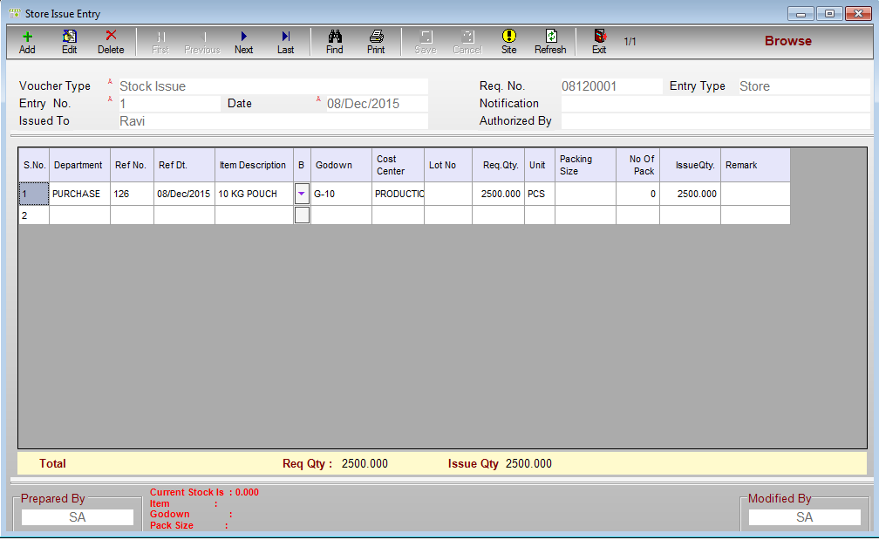
Store Issue Entry
Dataman.ERP

Slide 69
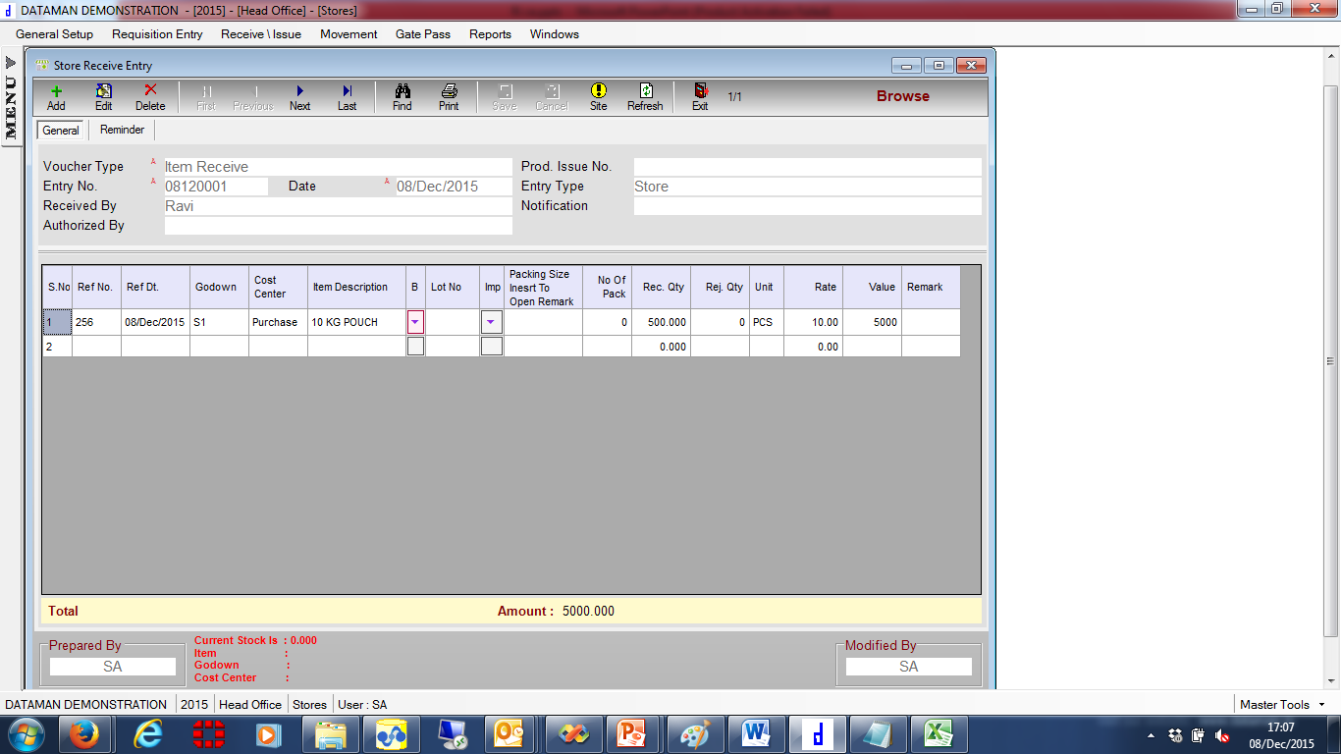
Store Receive Entry
Dataman.ERP

Slide 70
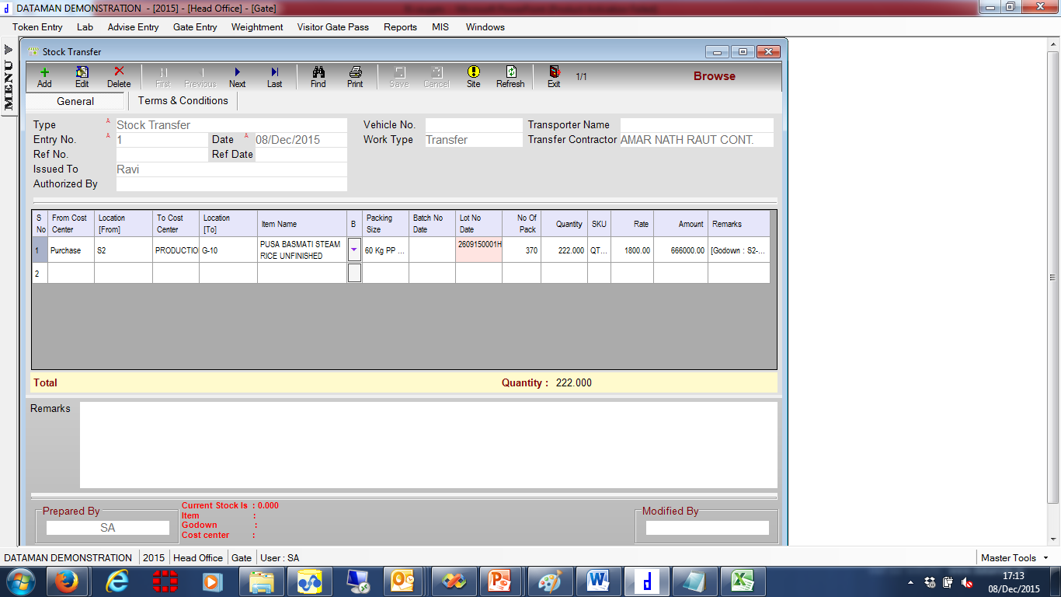
Stock Transfer
Dataman.ERP

Slide 71
Proposed Solution – Accounts
Dataman.ERP

Slide 72
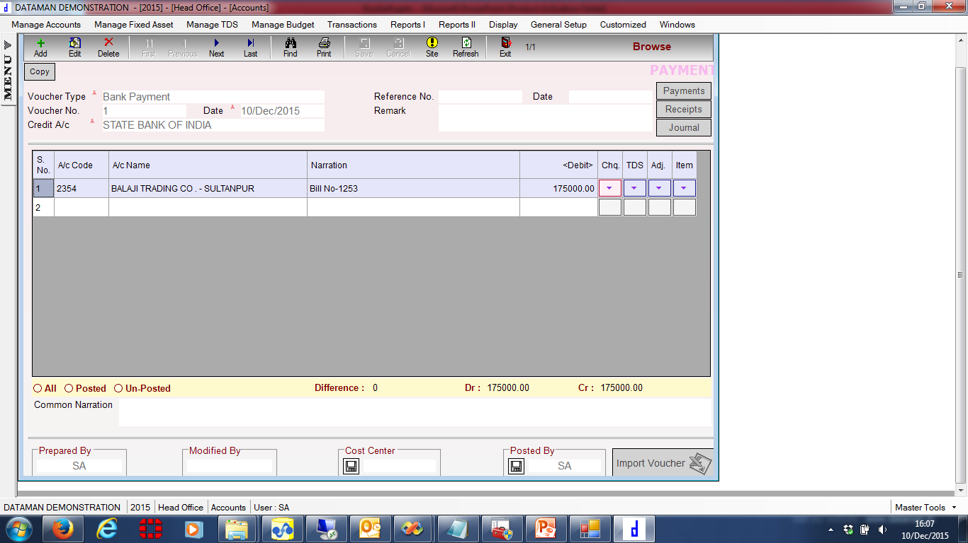
Voucher Entry
Dataman.ERP

Slide 73
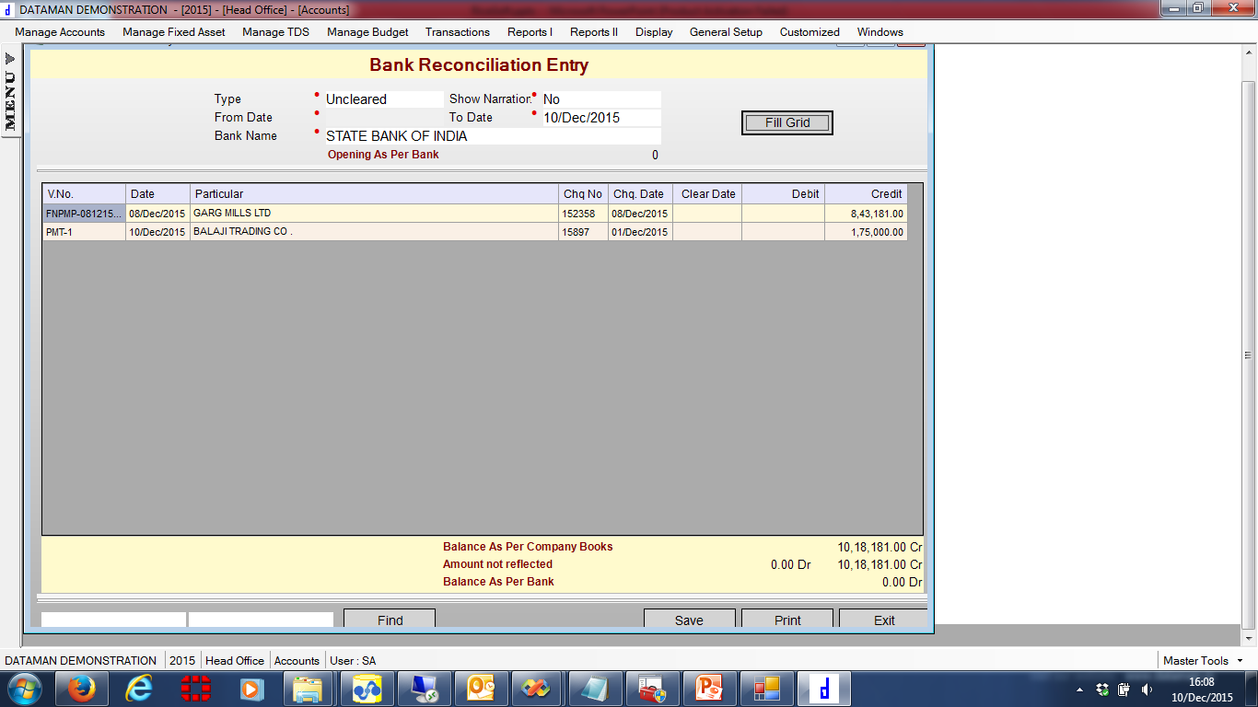
Bank Reconciliation Entry
Dataman.ERP

Slide 74
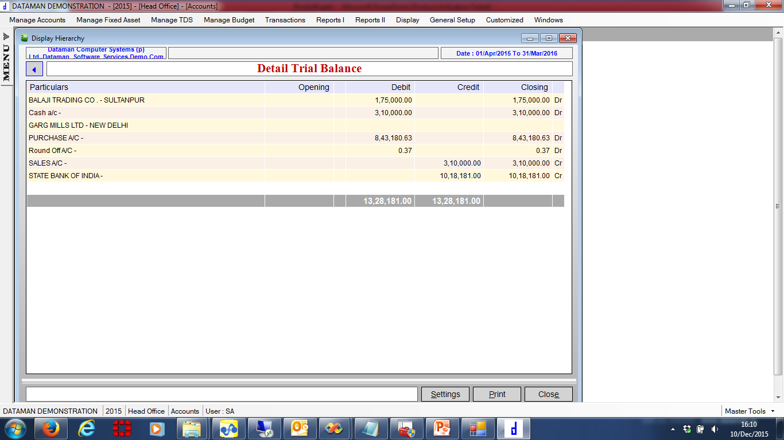
Detail Trial Balance
Dataman.ERP

Slide 75
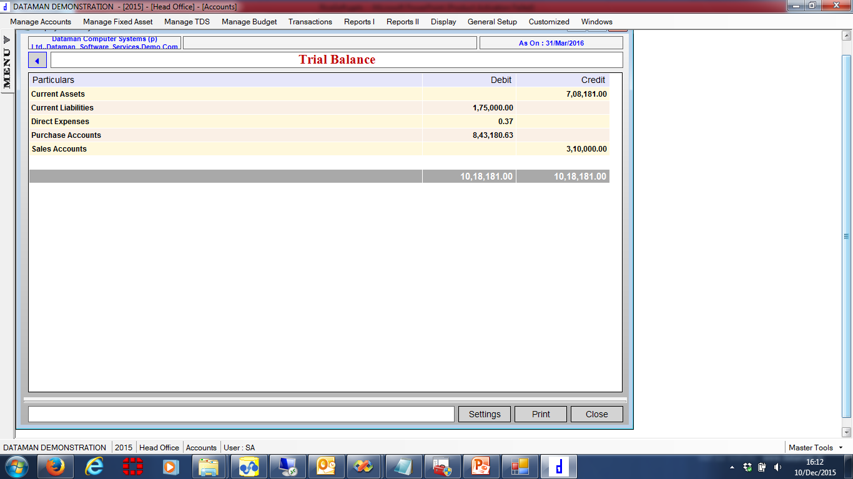
Trial Balance
Dataman.ERP

Slide 76
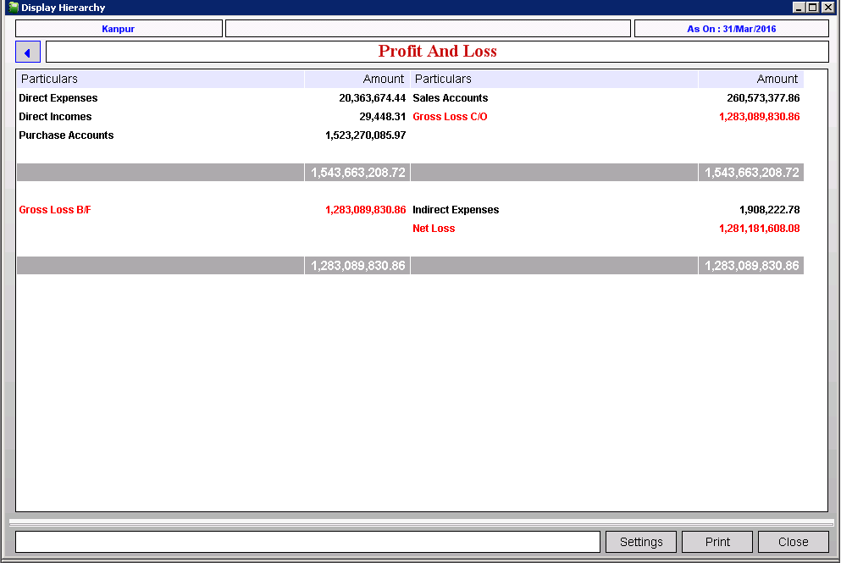
Profit And Loss
Dataman.ERP

Slide 77
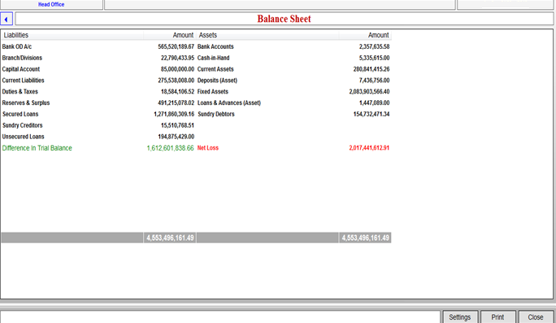
Balance Sheet
Dataman.ERP

Slide 78
Day Book
Dataman.ERP

Slide 79
Bank Book
Dataman.ERP

Slide 80
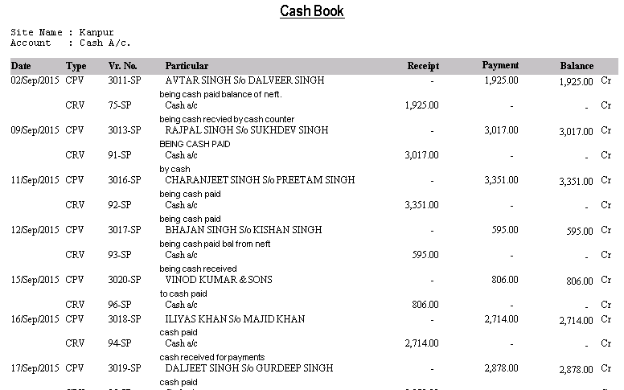
Cash Book
Dataman.ERP

Slide 81
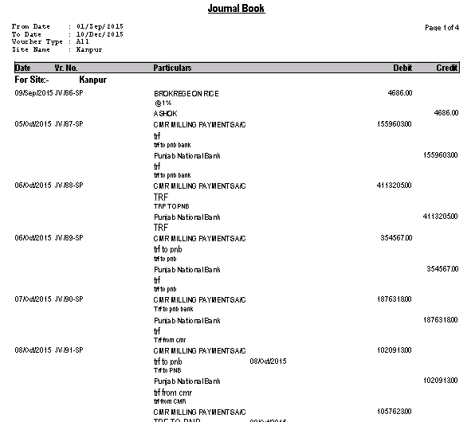
Journal Book
Dataman.ERP

Slide 82
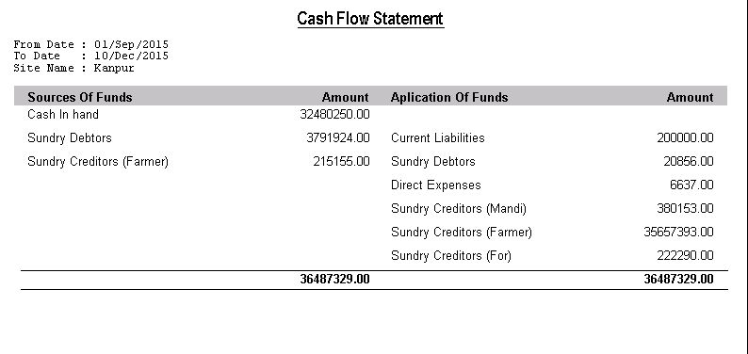
Cash Flow Statement
Dataman.ERP

Slide 83
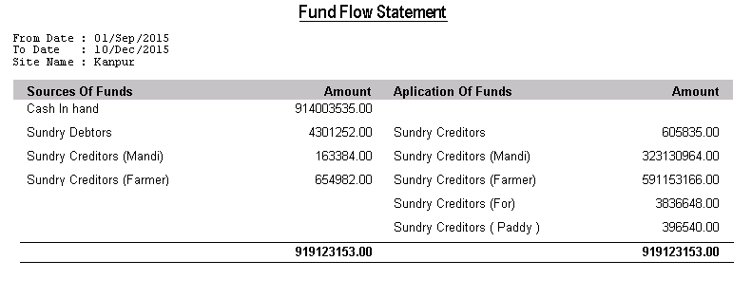
Fund Flow Statement
Dataman.ERP

Slide 84
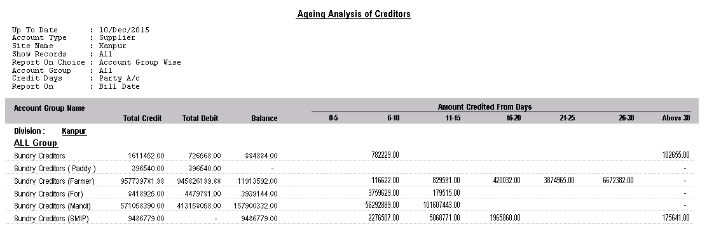
Ageing Analysis Bill Wise
Dataman.ERP

Slide 85
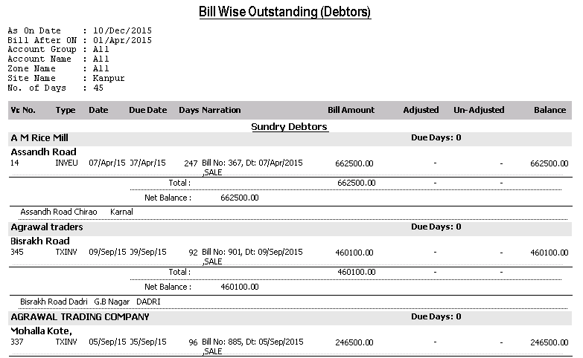
Bill Wise Outstanding (Debtors)
Dataman.ERP

Slide 86
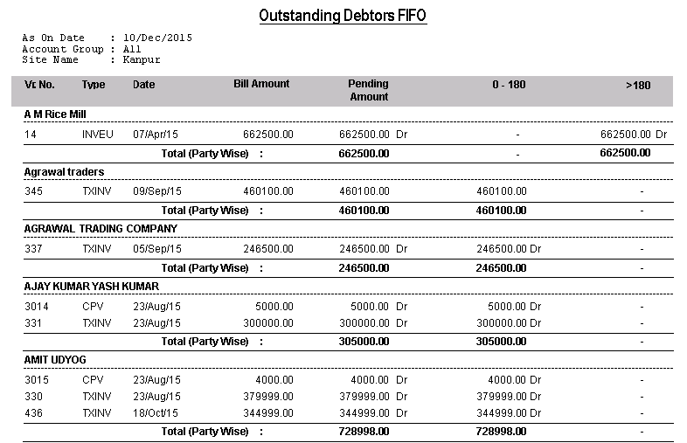
Outstanding Debtors FIFO
Dataman.ERP

Slide 87
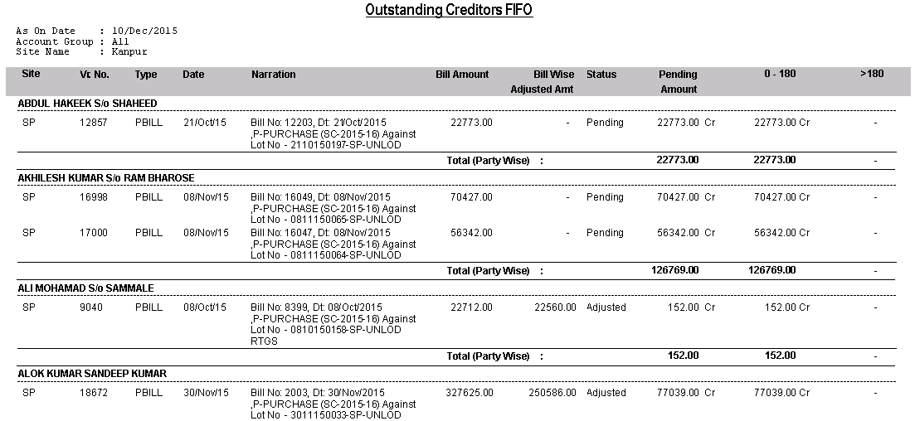
Outstanding Creditors FIFO
Dataman.ERP

Slide 88
Thank You! Seeking for a Win - Win relationship
Dataman.ERP

